Slide 1
COMP3017 Service Computing

Slide 2

Module Three: Service Discovery UDDI and Service Composition BPEL

Slide 3
XML-RPC
BPEL
SOAP
JEE
UDDI
UDDI
UDDI
WSDL
WSDL
SOA

Slide 4
Textbooks
Web Services Essentials
Chapter 7
Services Computing
Chapters 3.3-3.6
You can find an online version of this book for free through our library webpage

Slide 5
Module 3 Learning Outcomes
Understand the main concepts of UDDI﻿﻿﻿
Understand main uses of UDDI,﻿﻿﻿﻿
Understand the technical aspects of UDDI﻿﻿﻿﻿
Understand basic concepts of BPEL
Understand BPEL basic structure
Be able to create business process

Slide 6
Module 3 Guiding Questions
What is service discovery?
What is UDDI?
What is the relationship between XML, SOAP and UDDI?
What are the technical aspects of UDDI?
What are the main uses of UDDI?
Can you explain the UDDI data model in details?
How to search UDDI via web based interface?
How to use the UDDI programmatic API?
How to publish new companies and services to UDDI?

Slide 7
Module 3 Guiding Questions
What is service composition?
what is business process?
What is BPEL?
How to create the business process in BPEL?
What is the basic structure of BPEL document?

Slide 8
Service Discovery UDDI

Slide 9
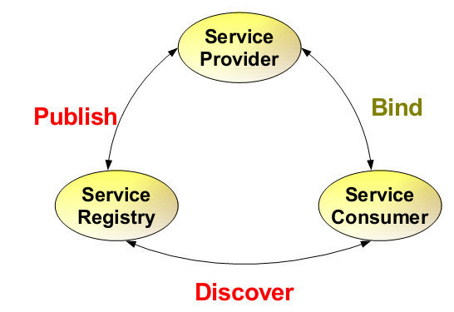
9

Slide 10
Service Architecture
UDDI(Universal Description, Discovery, and Integration ) defines a scheme to publish and discover information about Web services
10

Slide 11
Web Service Protocol Stack
Searching / Publishing Web Services
Discovery UDDI
Description WSDL
Describing Web Services interface
XML Messaging XML-RPC, SOAP,XML
Transport HTTP,SMTP,FTP, BEEP
Encoding messages in XML format
Transporting XML messages between client and server

Slide 12
Using the Protocols Together – service provider perspective
Step 1:
Create core functionality
Step 2:
Create an XML-RPC or SOAP service wrapper
Step 3:
Create WSDL service description
or XML-RPC integration instructions
Step 4:
Deploy service
Step 5:
Register new service via UDDI

Slide 13
Using the Protocols Together – service request perspective
Step 1:
Find Services via UDDI
Step 2:
Retrieve Service Description File:
WSDL or XML-RPC Instructions
Step 3:
Create XML-RPC or SOAP Client
Step 4:
Invoke Remote Service

Slide 14
Service discovery
Automatic detection of devices and services offered by devices on a computer network

Slide 15
Service discovery
Automatic detection of devices and services offered by these devices on a computer network
Requires a common language to allow software agents to make use of one another’s services

Slide 16
Service discovery
Automatic detection of devices and services offered by these devices on a computer network
Requires a common language to allow software agents to make use of one another’s services
Web Services Discovery

Slide 17
Service discovery
Automatic detection of devices and services offered by these devices on a computer network
Requires a common language to allow software agents to make use of one another’s services
Web Services Discovery
provides access to software systems over the Internet using standard protocols

Slide 18
Service discovery
Automatic detection of devices and services offered by these devices on a computer network
Requires a common language to allow software agents to make use of one another’s services
Web Services Discovery
provides access to software systems over the Internet using standard protocols
the process of finding suitable web services to a given task

Slide 19
Service discovery in Web Service Architecture
19

Slide 20
Credit Card
Hotel
Airline
Travel Agency 1
Travel Agency 2
Travel Agency 3
…
…
Service Registry
PUBLISH
Travel Agency 1
DISCOVER
PUBLISH
PUBLISH
Travel Agency 2
Travel Agency 3
Client App
Service providers
Service requestor/consumer

Slide 21
What is UDDI?
A project to speed interoperability and adoption for web services
21

Slide 22
What is UDDI?
A project to speed interoperability and adoption for web services
Standards-based specifications for service description and discovery
22

Slide 23
What is UDDI?
A project to speed interoperability and adoption for web services
Standards-based specifications for service description and discovery
Shared operation of a business registry on the web
23

Slide 24
What is UDDI?
A project to speed interoperability and adoption for web services
Standards-based specifications for service description and discovery
Shared operation of a business registry on the web
Partnership among industry and business leaders
24

Slide 25
What is UDDI?
Programmatic registration and discovery of business entities and their Web services
Based on SOAP, HTTP, XML
Registry data
Business registrations
Service type definitions
25

Slide 26
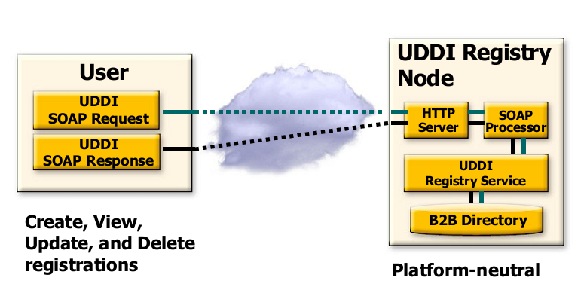
UDDI Runs “Over” SOAP
Registry data

Slide 27
Why UDDI or something like UDDI?
• Platform independent service
publication and discovery

Slide 28
Why UDDI or something like UDDI?
• Platform independent service
publication and discovery
• Enables dynamic service discovery

Slide 29
Dynamic service discovery
Weather forecast
Service provider
Client App
Service requestor/consumer

Slide 30
Dynamic service discovery
Service provider
Client App
Service requestor/consumer

Slide 31
Dynamic service discovery
?
Service provider
Client App
Service requestor/consumer

Slide 32
Dynamic service discovery
?
Service provider
Client App
Weather forecast
2
Weather forecast
3
Service requestor/consumer

Slide 33
Dynamic service discovery
Credit Card
Hotel
Airline
Weather forecast 1
Weather forecast 2
Weather forecast 3
…
…
Service Registry
PUBLISH
Weather forecats1
DISCOVER
PUBLISH
PUBLISH
Client App
Weather forecast
2
Weather forecast
3
Service providers
Service requestor/consumer

Slide 34
UDDI Vision - 2000
Open industry initiative, enabling businesses to discover each other and define how they interact over the Internet

Slide 35
UDDI Vision - 2000
Open industry initiative, enabling businesses to discover each other and define how they interact over the Internet
Global e-commerce driven by dynamically emerging business relations

Slide 36
UDDI Vision - 2000
Open industry initiative, enabling businesses to discover each other and define how they interact over the Internet
Global e-commerce driven by dynamically emerging business relations
Consumers of web services would be linked up with providers through a public or private dynamic brokerage system

Slide 37
UDDI Vision - 2000
Open industry initiative, enabling businesses to discover each other and define how they interact over the Internet
Global e-commerce driven by dynamically emerging business relations
Consumers of web services would be linked up with providers through a public or private dynamic brokerage system
Anyone needing a service would go to their service broker and select a service supporting the desired SOAP service interface, and meeting other criteria

Slide 38
UDDI Vision - 2000
Open industry initiative, enabling businesses to discover each other and define how they interact over the Internet
Global e-commerce driven by dynamically emerging business relations
Consumers of web services would be linked up with providers through a public or private dynamic brokerage system
Anyone needing a service would go to their service broker and select a service supporting the desired SOAP service interface, and meeting other criteria
The publicly operated UDDI node or broker would be critical for everyone

Slide 39
UDDI Vision - 2000
Open industry initiative, enabling businesses to discover each other and define how they interact over the Internet
Global e-commerce driven by dynamically emerging business relations
Consumers of web services would be linked up with providers through a public or private dynamic brokerage system
Anyone needing a service would go to their service broker and select a service supporting the desired SOAP service interface, and meeting other criteria
The publicly operated UDDI node or broker would be critical for everyone
For the consumer – public or open brokers would only return services listed for public discovery by others

Slide 40
UDDI Vision - 2000
Open industry initiative, enabling businesses to discover each other and define how they interact over the Internet
Global e-commerce driven by dynamically emerging business relations
Consumers of web services would be linked up with providers through a public or private dynamic brokerage system
Anyone needing a service would go to their service broker and select a service supporting the desired SOAP service interface, and meeting other criteria
The publicly operated UDDI node or broker would be critical for everyone
For the consumer – public or open brokers would only return services listed for public discovery by others
For service producer – matadata of index categories would be critical for effective placement

